Slide 1
Reinforcement Learning

Slide 2
Reinforcement Learning
In reinforcement learning, the features at any given point are called STATE (s) and the task is for find a function that maps a state to an ACTION (a).
One way to solve this problem is using Supervised Learning, however, it is not a good approach – for example, if we train a neural network on state-action pairs, we could use it to predict an action given a state, however, it is difficult to get a dataset of ideal state-action pairs and actions and states can take up multiple values.
One key input for the reinf algo is the reward function – it gives FEEDBACK whether the action was correct or in-correct. The task of the reinf algo is to get the maximum reward for its action.
Specifying the reward rather than the optimal action gives more flexibility on designing the reinf system. Thus, the algorithm decides what to do rather than how to do it.
Defining the reward system to give positive rewards for good actions, negative rewards for bad actions, and very negative rewards for very poor actions incentivizes the algorithm to take the desired action.
Application areas:
Controlling robots
Factory optimization (rearranging, maximizing throughput and efficiency)
Stock trading (sequence out trade over time to buy/sell shares to the best possible price)
Video games (automated playing)

Slide 3
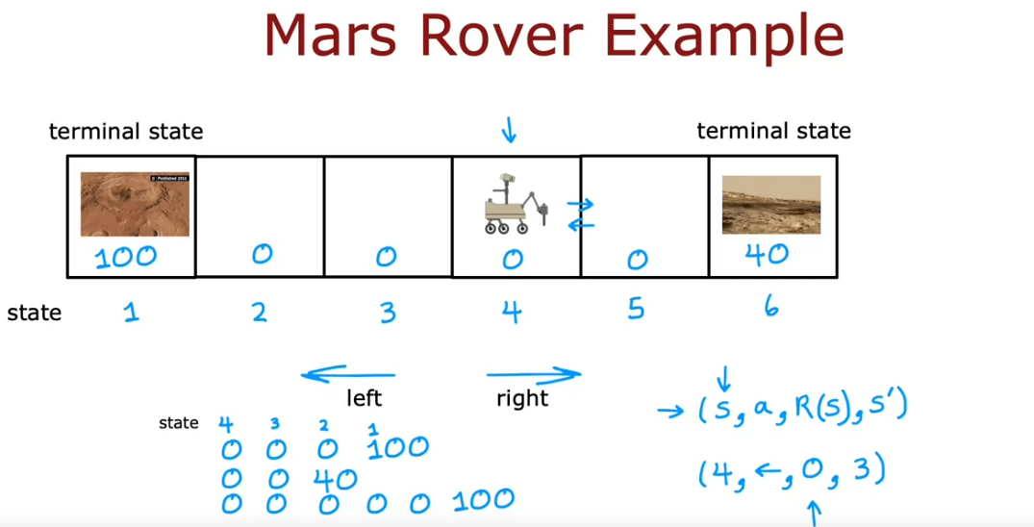
The key idea of reinf learning is – rather than telling the algo the right answer Y for every input, we instead specify the reward function that tells it when it is doing well and when its doing poorly, and the algo automatically figures out the good action.
Algorithm Details
We first define different States a system can take (the example snapshot has 6 states). We then define a reward function for each state (given by 100, 0, …, 40). At each state, the system can take multiple actions (left or move right). We then calculate the reward at each step for all the possible paths to the terminal state.
The above is represented by the function –
(s, a, R(s), s-prime). The core elements of the reinf algo are:
At every time step, the robot/system is in some state s
It gets to choose an action a
It gets some reward [R(s)] that it gets from state s
As a result of its action, it gets to a new state s-prime.
To know if a particular set of rewards are better or worse, we calculate the return – the return tries to capture the rewards that are quicker and maybe more attractive vs rewards that are longer to achieve.

Slide 4
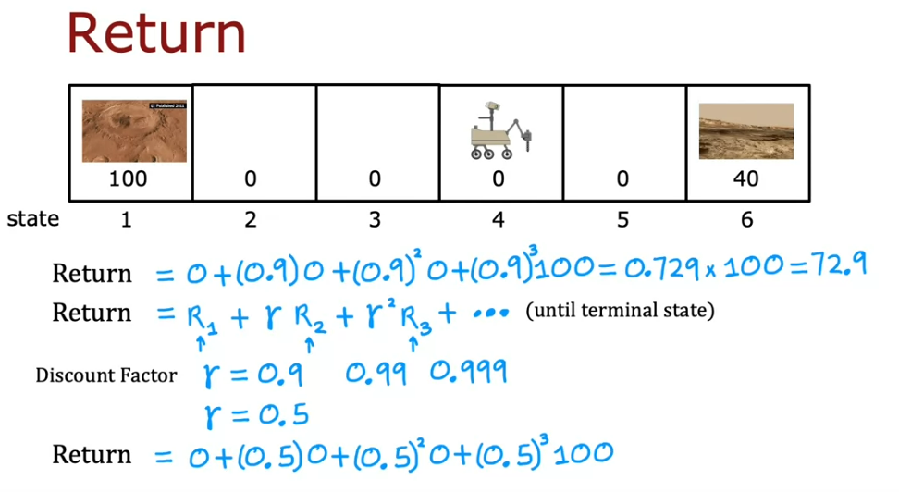
The return is defined as the sum of each reward weighted by a discount factor (GAMMA) such that each additional step to reach to the terminal state is exponentially discounted. In many reinf algos, the common choice of discount factor is a value close to but less than 1. In financial applications, the discount factor is a natural interpretation of the interest rate or time-value of money

Slide 5
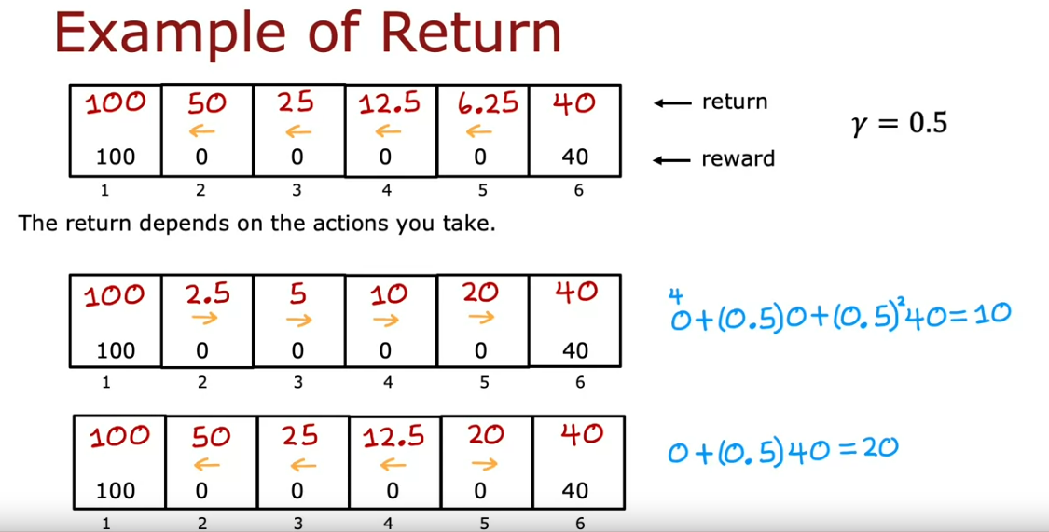
We can calculate the discount factors for all states starting from the terminal state and backwards. In the below example, to calculate the sequence of the discounts from all the states starting the terminal state 1 to state 5, for gamma = 0.5, we keep exponentially decreasing (halving) in this case till state 5. The return for the last state is 40 and thus its discounting factor is 1. This is the first example in the image.
Likewise, starting the terminal state 6, we can calculate all the rewards/discounts for a given direction and a given gamma. This is the 2nd example in the image.
Actions are taken based on the current state. For example, if we start at state 5 and take right, we multiply the reward (0) with the discounting factor for moving right (20) for state 5, and then for state 6 we multiply the discounting factor squared for reward (40). If a step is taken, the discounting factor needs to be applied. This is the 3rd example in the image.

Slide 6
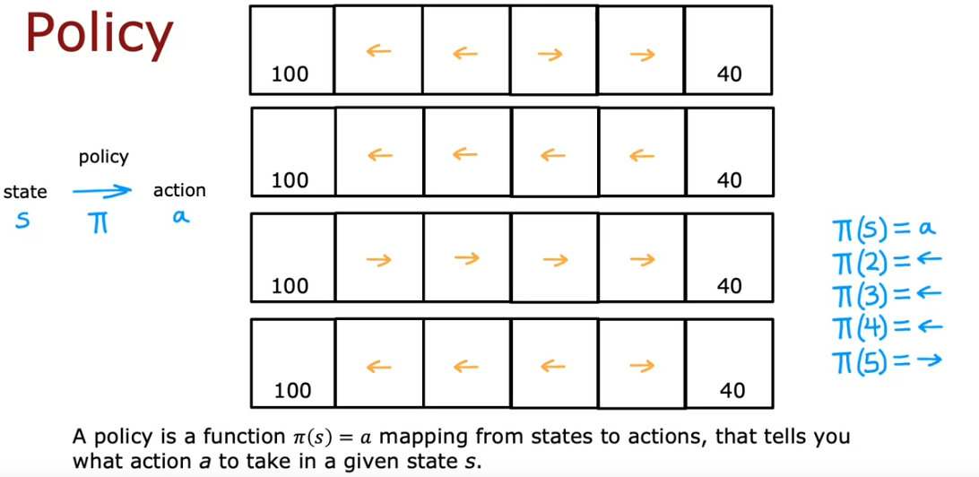
To summarize, the return is the sum of rewards that a system gets by weighing the discount factor where rewards in the far future are weighed by a discount factor having a higher power.
If instead, we have negative discounts, then the discount factor incentivises the system to push out negative rewards as far into the future as possible.
Formalization of the Algorithm
There are different ways of choosing an action given a state:
We could always decide to go nearer to the positive reward (example 1 in the image)
We could always go for the larger reward regardless of the current state (example 2 in the image)
Alternatively, we could always go for the smaller reward (example 3)
Or you could follow a custom path – choosing left unless you are one step away from the reward (example 4)
In the reinf algo, our goal is to come up with a function called the POLICY (Pi). The job of the policy is to take as input any state (s) and map it to the action (a) that the policy wants to take. The policy in the above image is for example 4.

Slide 7
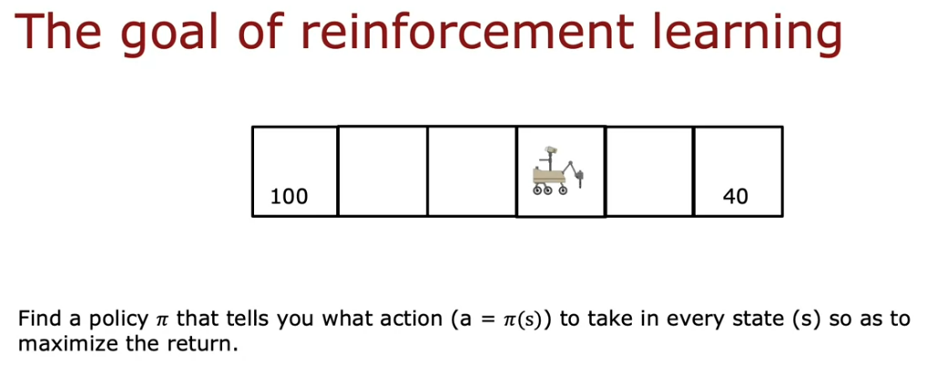
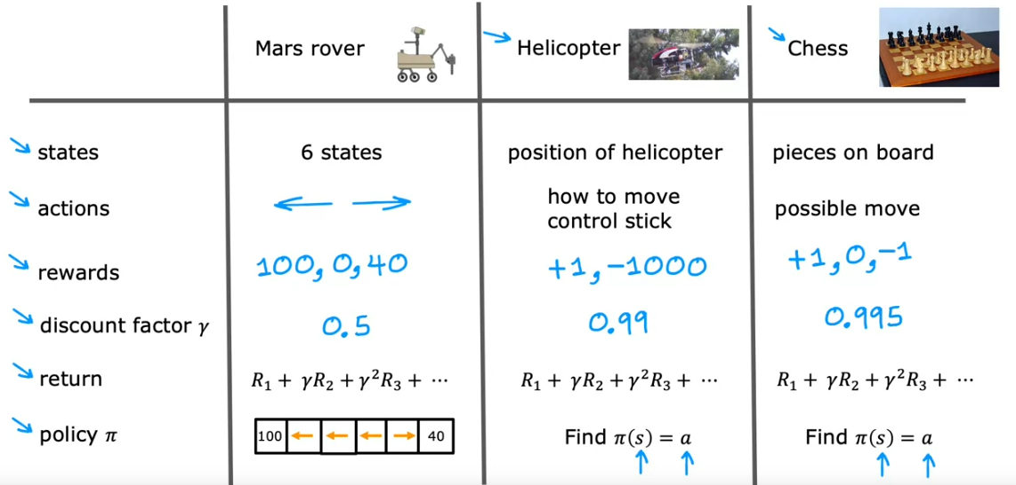
Thus, the goal of reinforcement learning is to find a policy PI(s) that tells you what action to take at every state to maximize the return. Maybe calling PI a “controller” rather than a policy would be a more natural terminology.
Review of Key Concepts

Slide 8
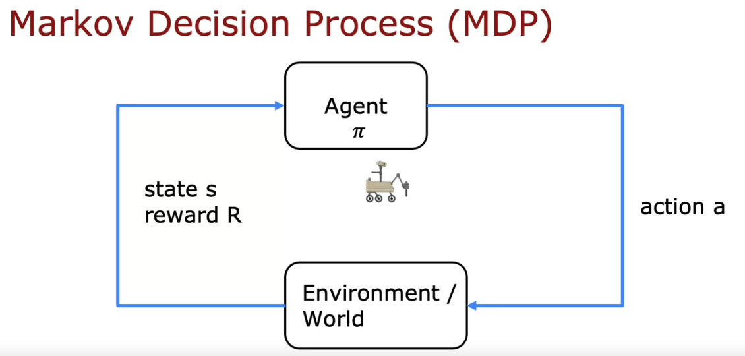
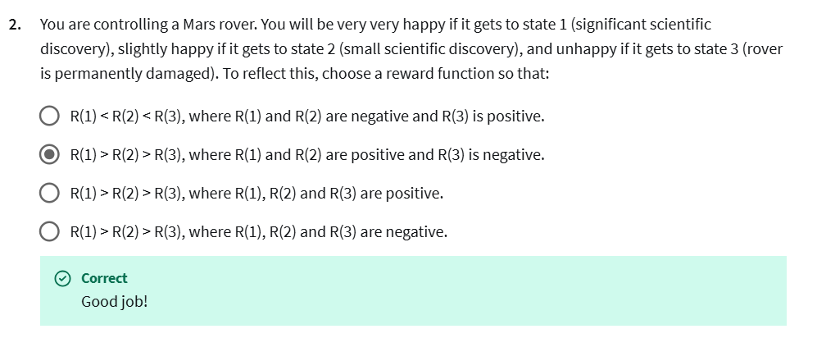
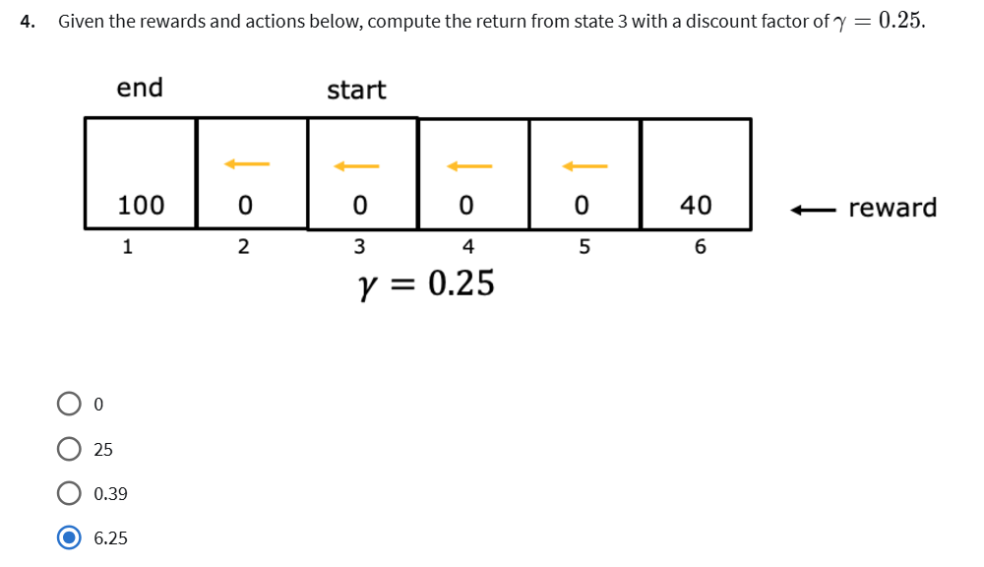
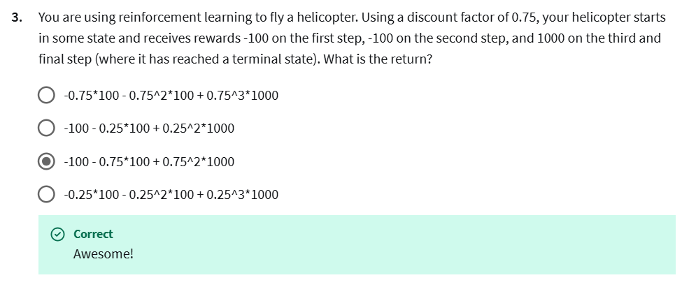
The formalization of reinf is called Markov Decision Process (or MDP). Markov refers to a process in which the future only depends on the current state and not anything that might have occurred prior to getting to the current state. Basically, the future depends on where you are now and not how you got here.

Slide 9
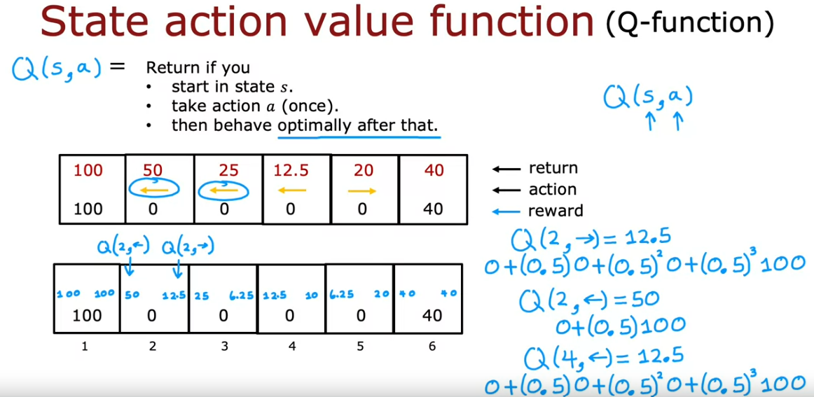
State Action Value Function
The key quantity that reinf is trying to compute is called the State Action value function or the Q-function Q(s,a). Q(s,a) is the return if you:
Start with state s
Take action a once
Then behave optimally after that by taking the action according to the policy (resulting in the highest possible return)
Example – for the policy below (first horizontal box), if we want to calculate Q(2, right), then we will go from state 2→3, 3→2, 2→1 because the optimal policy till state 4 is left. Thus, the return Q(2, right) = 12.5. Similarly, starting state 2, if we go left Q(2, left) = 50. Performing a similar exercise for the same optimal policy for Q(4, left) = 12.5. Lastly, Q(4, right) = 0 + (0.5)(0) + (0.5)(0.5)(40) = 10

Slide 10
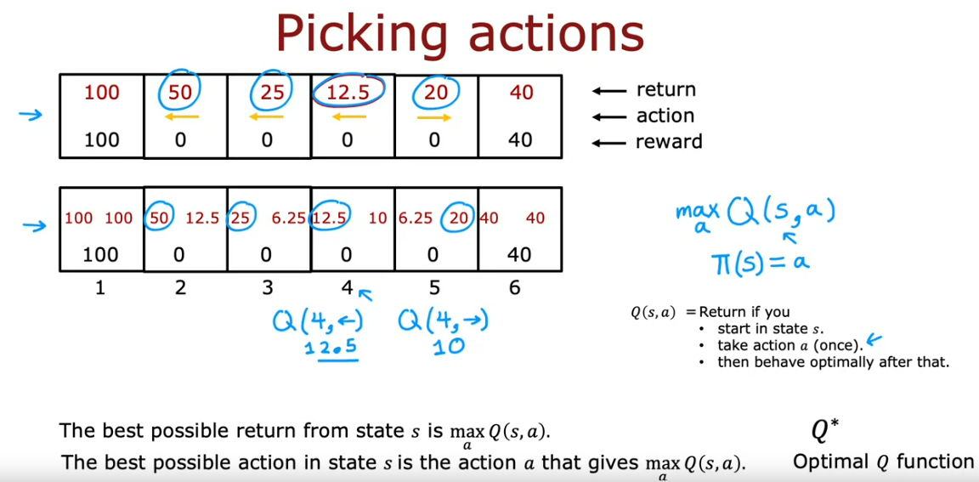
Once we compute the Q-fn, it gives a way to pick actions as well – the best possible return from State s is the largest value of Q(s,a) maximizing over a. The best possible action in State s is the action that maximizes Q(s,a).
Alternatively, in order to earn the biggest possible return, take the action that results in the biggest total return. If we can compute Q(s,a) for every state and every action, we can find the optimal policy Pi (S).
Note that the Q function is also known as the Q* or Optimal Q-function.

Slide 11
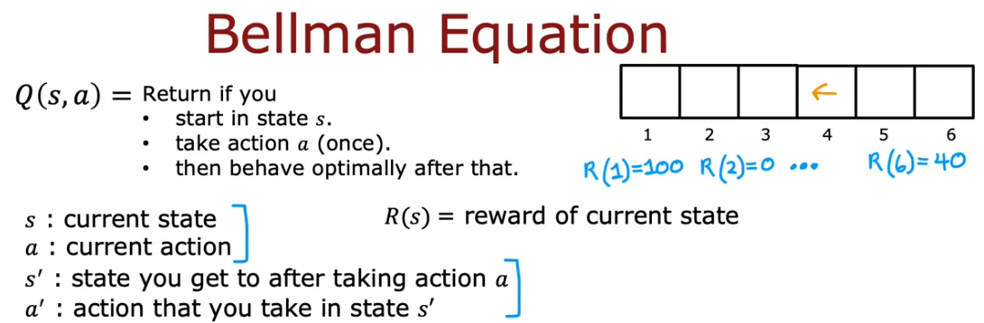
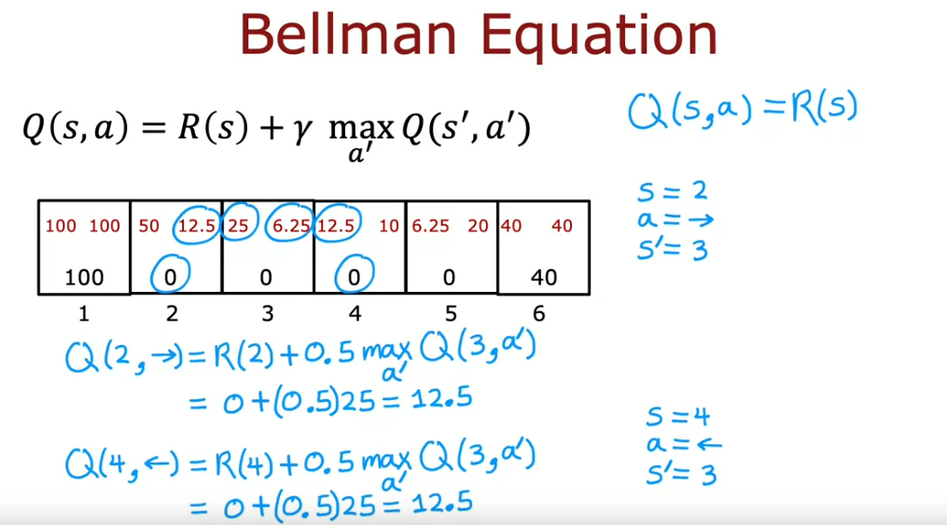
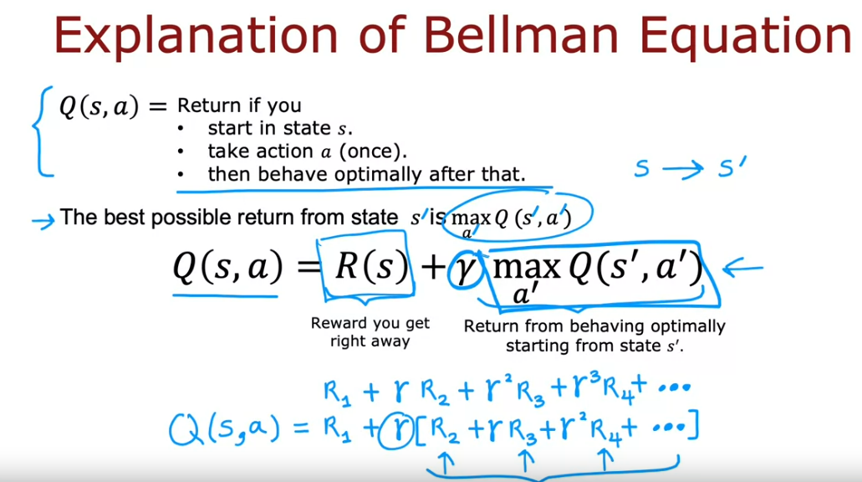
Bellman Equation
To summarize, if we can compute the state action value function for Q(s,a) for every state, we can pick a good value for action from every state.
In the terminal state, the bellman equation simplifies to Q(s,a) = R(S). Sample calculation for a policy

Slide 12
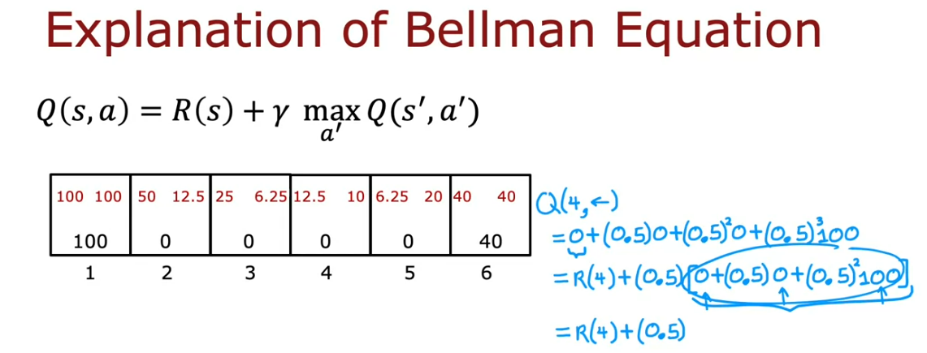
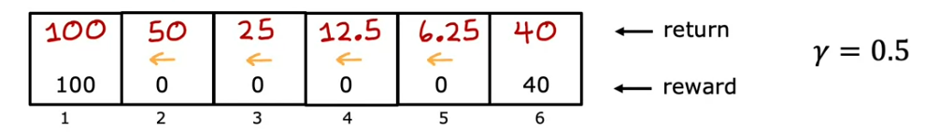
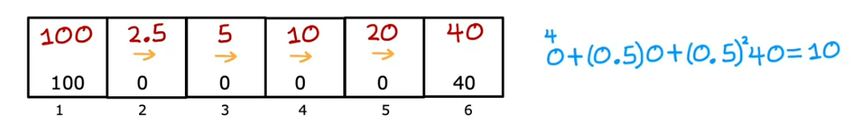
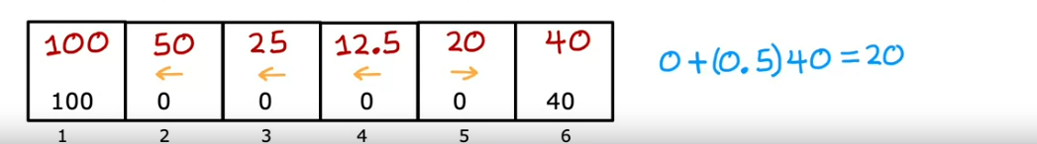
In depth explanation:
[All Left rewards]
[All Right rewards]
[Policy based on Max rewards]

Slide 13
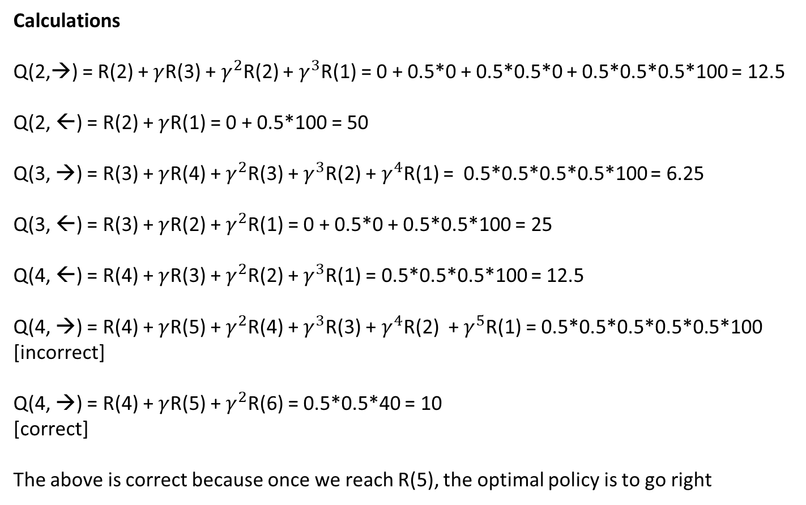
Calculations
Q(2,→) = R(2) + $γ$R(3) + $γ^{2}$R(2) + $γ^{3}$R(1) = 0 + 0.5*0 + 0.5*0.5*0 + 0.5*0.5*0.5*100 = 12.5
Q(2, ←) = R(2) + $γ$R(1) = 0 + 0.5*100 = 50
Q(3, →) = R(3) + $γ$R(4) + $γ^{2}$R(3) + $γ^{3}$R(2) + $γ^{4}$R(1) = 0.5*0.5*0.5*0.5*100 = 6.25
Q(3, ←) = R(3) + $γ$R(2) + $γ^{2}$R(1) = 0 + 0.5*0 + 0.5*0.5*100 = 25
Q(4, ←) = R(4) + $γ$R(3) + $γ^{2}$R(2) + $γ^{3}$R(1) = 0.5*0.5*0.5*100 = 12.5
Q(4, →) = R(4) + $γ$R(5) + $γ^{2}$R(4) + $γ^{3}$R(3) + $γ^{4}$R(2) + $γ^{5}$R(1) = 0.5*0.5*0.5*0.5*0.5*100
[incorrect]
Q(4, →) = R(4) + $γ$R(5) + $γ^{2}$R(6) = 0.5*0.5*40 = 10
[correct]
The above is correct because once we reach R(5), the optimal policy is to go right

Slide 14
Random Environments
There is a generalization of reinf which models random and stochastic environments – there could be a probabilistic chance of the recommendation not being followed by the reinf system due to external (uncontrollable) features → for example, the helicopter may not be able to take a right due to the wind conditions. This could be modelled as a probability – for example, 0.9 chance of going right vs 0.1 chance of going left.
When the reinf learning algo is stochastic, there isn't one sequence of rewards that you see for sure but you see a sequence of different rewards.
Thus, in a stochastic reinf, we are not interested in maximizing the return as it is a random number, we instead maximize the average value of the sum of discounted rewards.
This means if you take a policy and try it out many many times, you get lots of different reward sequences and taking an average over all the sequences will be the expected return. Thus, the job of the algorithm becomes maximizing the average/expected sum of discounted rewards.
In a stochastic process, optimal return values will be lower than previously calculated as they are less controllable. In the optional lab (slide 56), this is reflected by the value of missteped probability

Slide 15
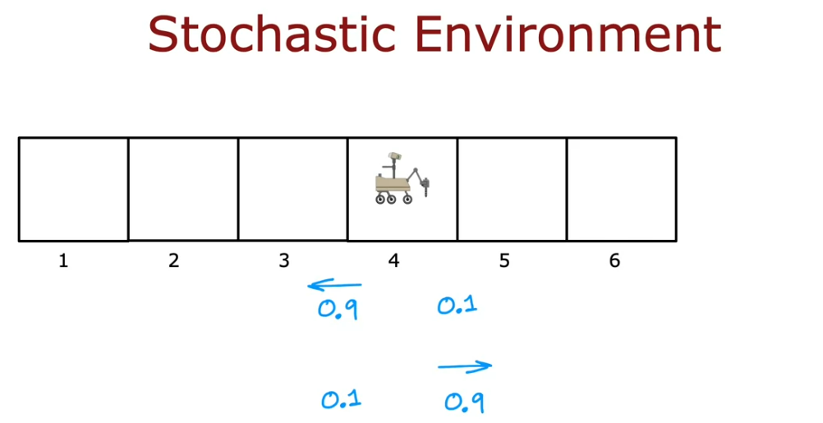
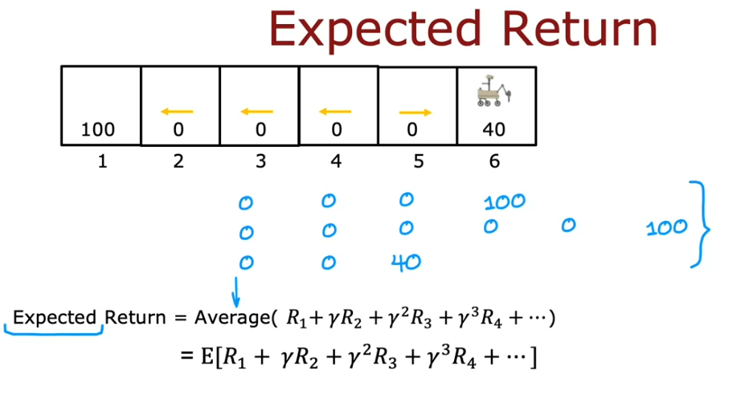
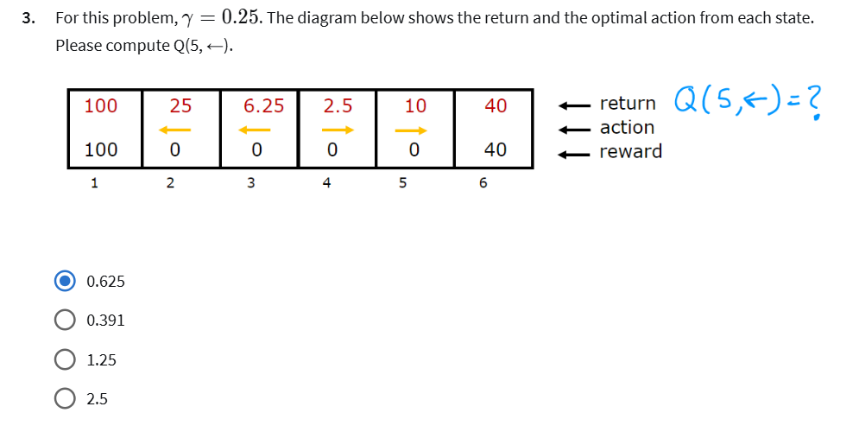
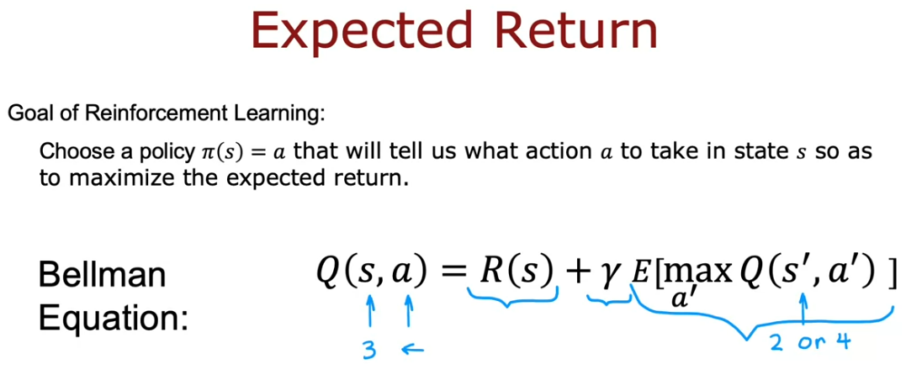
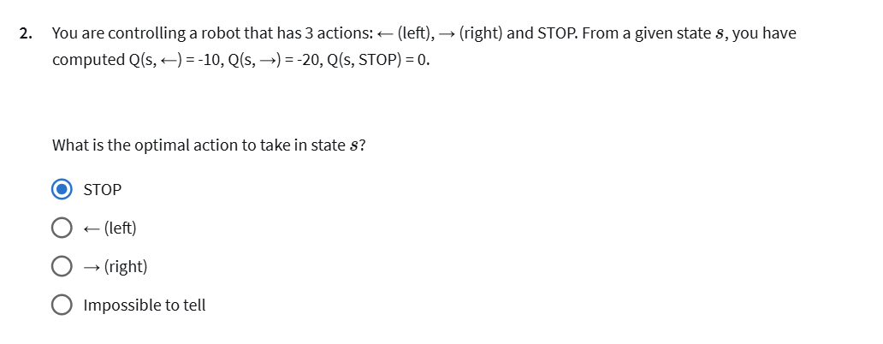

Slide 16
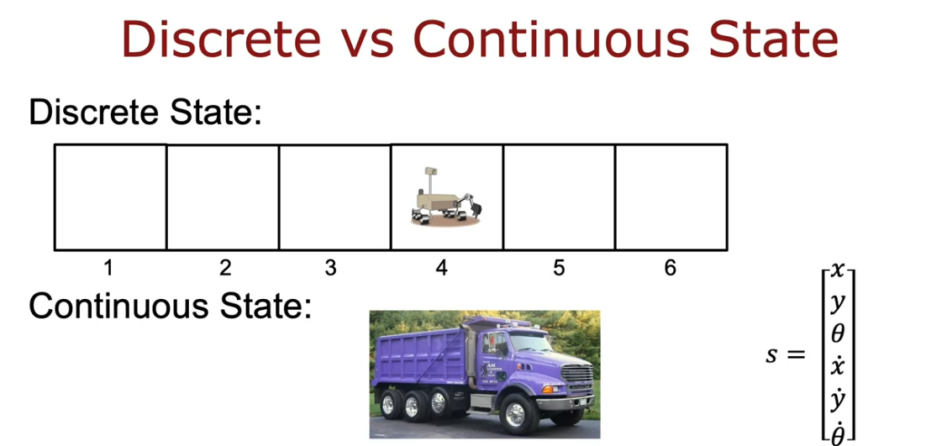
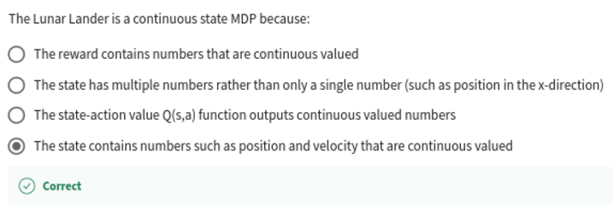
Continuous State Spaces
Some systems can take up very large number of continuous value positions. For example, for a truck or a car, the state might not include one number but many other numbers. The states of the truck could include its x,y position, its orientation, its velocity in the x,y direction and how quickly the angle of the truck changes. This is different from 1 of the 6 states in the previous section.
To summarize, in the continuous state space, the number of states are defined but the state can take a continuous value. For the truck example, the states are 6 but each state can take up a continuous value. In the discrete state space, the state can take up a discrete value. For the mars rover example, the possible state were 6 but the state value could be left or right only.

Slide 17
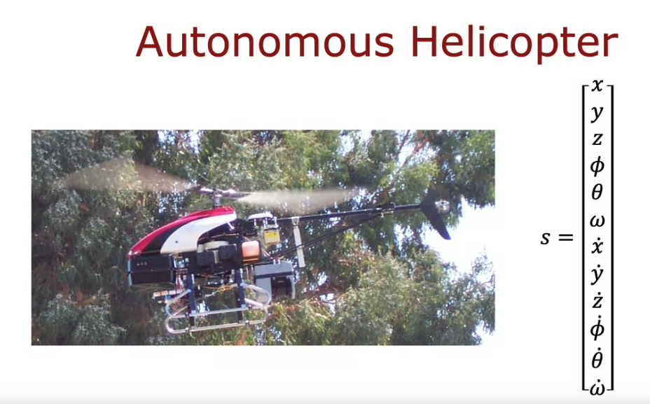
For the helicopter, the states are:
Xyz position in space
Rolling of the helicopter – pitch and yaw
Speed/velocity variables
A continuous state reinf algo is also know as a continuous state MDP (Markov Decision Process) and the state can take a vector of numbers of any large number of values.
Deep Reinforcement Learning
The key idea is that we will train a NN to compute the Q(s,a) function and that in turn will help pick the best actions. We input the current state to the NN and compute Q(s,a). In fact, we input the current state as input vector [s a] along with the current action based on the current state. Usually, actions are encoded as one-hot feature vectors. Also, the NN is embedded within the reinf algo.

Slide 18
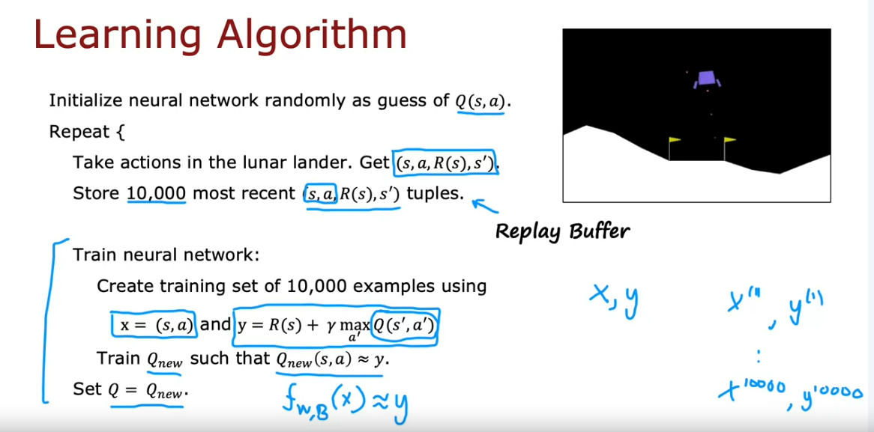
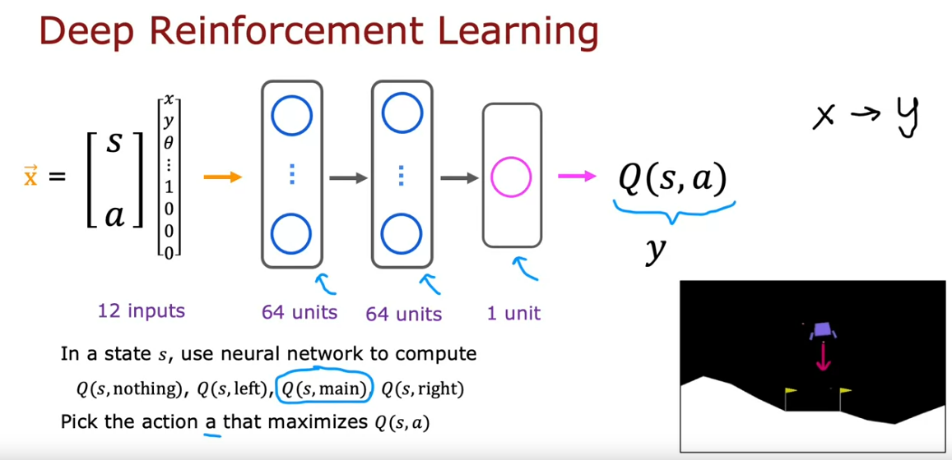
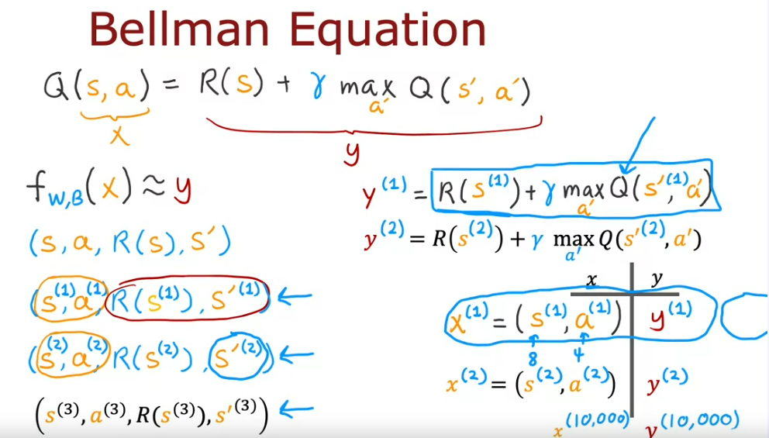
When we are in some state S, we can use the NN to compute Q(s,a) for all possible actions and then the corresponding actions will be picked based on the highest value.
In order to train the NN, we use bellman’s equation to create a training set with many x,y pairs. To simulate a training set, we take actions randomly and capture the state-action value pairs along with the next state & action.
The technique of storing the most recent examples is called Replay Buffer. Also storing 10,000 examples is common practice.

Slide 19
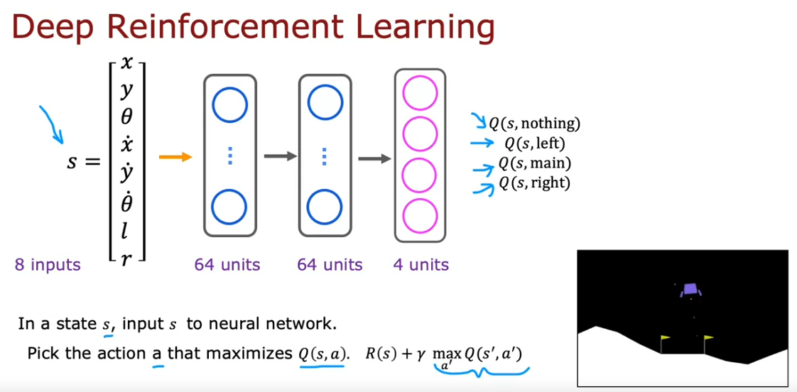
Thus, you start with a random guess for the Q function and use bellman’s equation to repeatedly try and improve the estimate of the function. By doing this over and over, we improve the guess of the Q function using NNs. Thus, each iterative model is a slightly better guess of the Q function. This is also know as the Deep Q-Network (DQN) algo.
Refinements: In the current architecture, we have to carry out inference multiple times to decide one action for each state. Instead, we can use a single NN to output all values of the action.

Slide 20
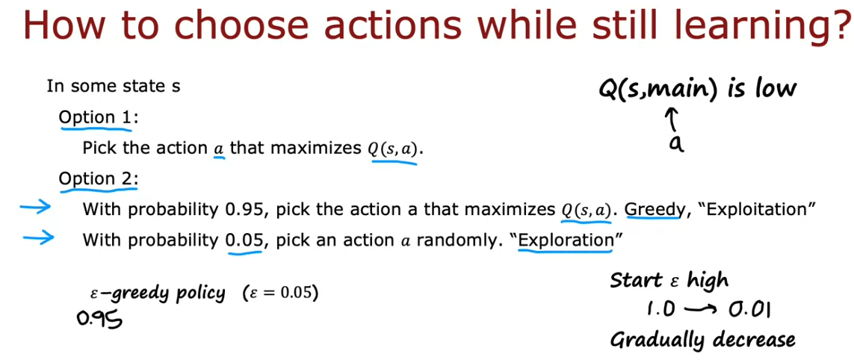
Further Algorithm Refinement – Epsilon Greedy Policy
When the learning algorithm is still learning, we do not really know the best action for every state. Some options are:
Pick an action that maximizes Q(s,a)
With 0.95 probability, pick an action that maximizes Q(s,a) [Greed/Exploitation Step]
With 0.05 probability, pick a random action [Exploration Step]
Option 2 is the better option because the not-so-common actions are also learned. Thus, it avoids the algorithm to never try out new options. Thus, there is an exploitation vs exploration trade off. Here the epsilon = 0.05. Also, its common practice to start with a high epsilon and gradually decrease.
One problem with this approach is that due to the addition of epsilon, the number of training steps exponentially increase causing many more cycles to train the algo.

Slide 21
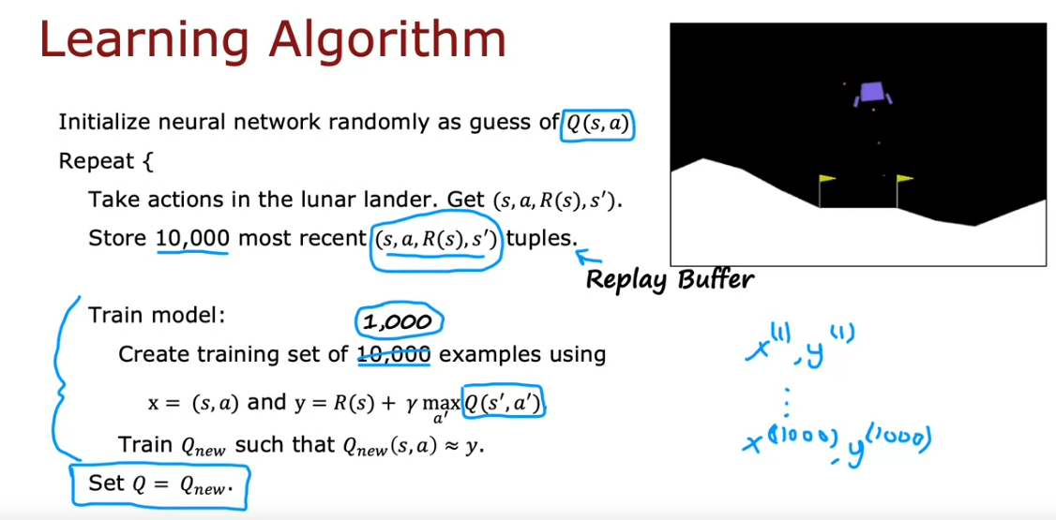
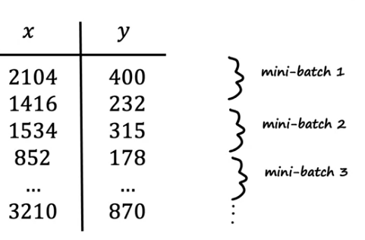
2 Additional Refinements – Mini Batch & Soft Updates
Minibatch – on every iteration of gradient descent, SUBSEQUENT chunks of the training set are provided to learn the parameter. In batch gradient descent, we use all training examples and each step of gradient descent causes the algorithm to reliably get closer to the global minimum. In contrast, in mini batch, gradient descent follows a slightly more random path but on AVERAGE will tend towards the global minimum. This is much more computationally inexpensive. For the reinf algo, we use values mini-batch values from the replay buffer for training.

Slide 22
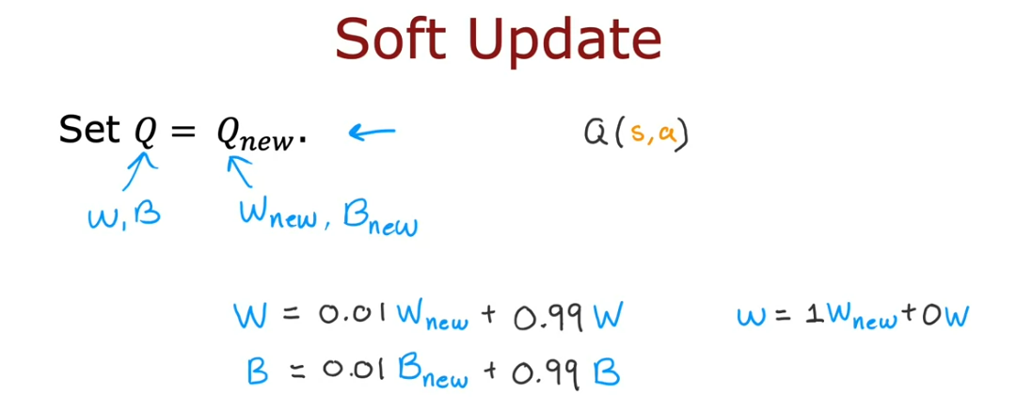
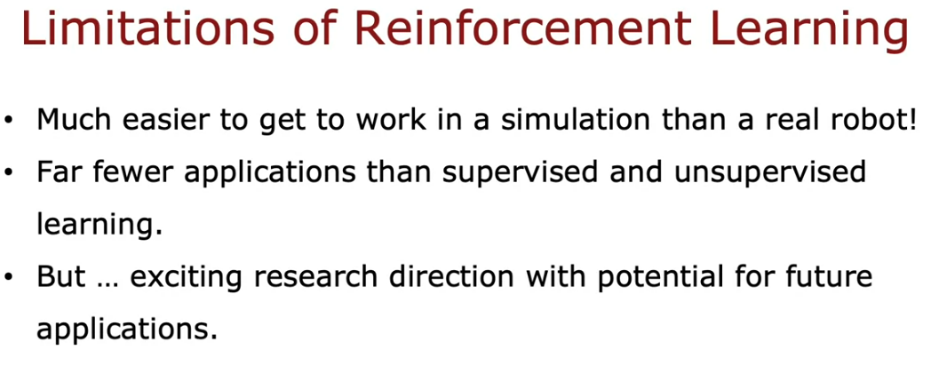
Soft Updates – Currently, in the last step of the algorithm we replace Q = Qnew. However, this can cause Qnew to be actually worse than the original Q. In the soft update method, we prevent Qnew to go through just one unlucky step of getting worse. Thus, we control how aggressively we want to change the new weights. Thus, we make more gradual changes to the weights.
Limitation of Reinf

